Slide 1
Netflix Analytics
BY
-V S MONISH KUMAR
-I. VENKATA VINAY
-RAJU KUSUMA
-HARISHA V
-Y.SOWMIKA

Slide 2
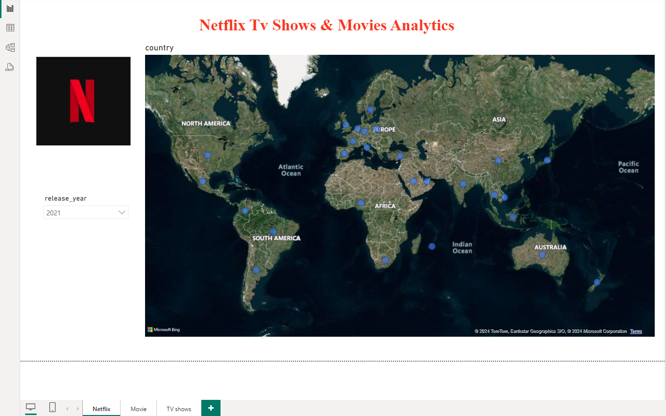

Slide 3
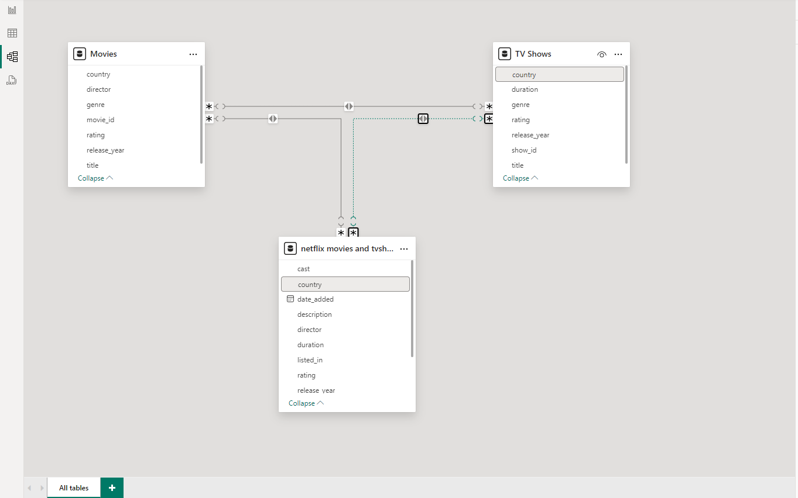
MODEL VIEW

Slide 4
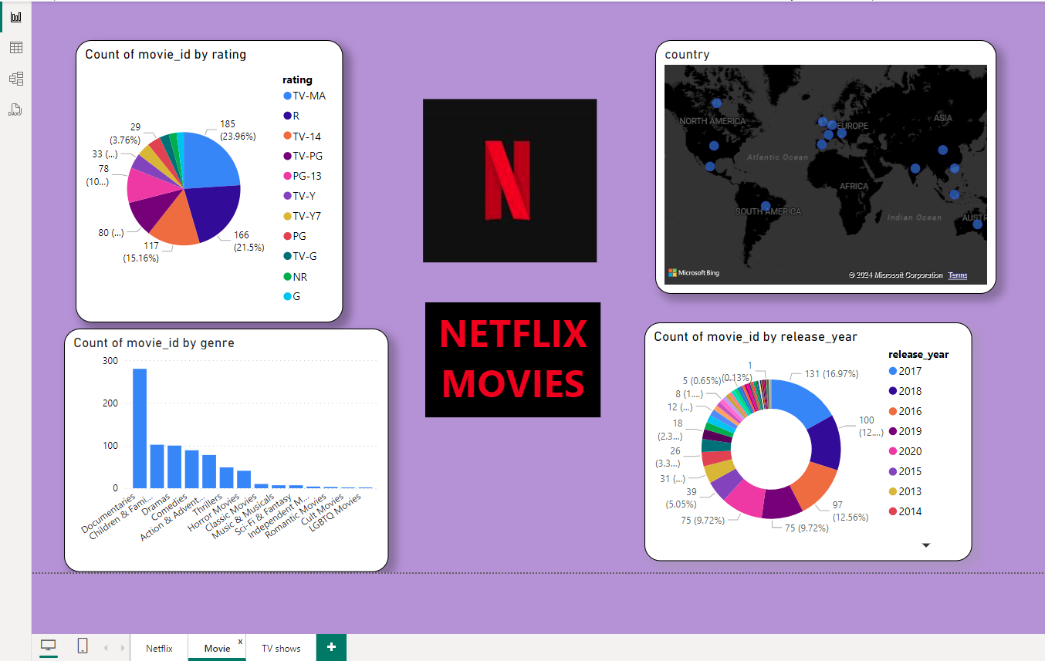

Slide 5
